Slide 1
Managing the project team
Nicole Herrington

Slide 2
4 critical factors in people management
Consistency
Respect
Inclusion
Honesty

Slide 3

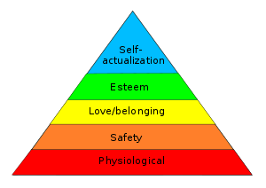
Motivating people
Personal development
Feeling respected by others
Feeling part of a social group
Feeling secure in an environment
Food, sleep, etc.

Slide 4
Motivating people: personality
Task-oriented: motivated by the challenge of software development
Self-oriented: motivated by personal success
Interaction-oriented: motivated by co-workers (group work)

Slide 5
Selecting group members
Balance of technical skills and personalities
A group with complementary personalities may work better than a group that is selected solely on technical ability

Slide 6
Try to avoid…
Large groups
Hierarchical structure
Groups with similar personalities
Inadequate meeting space
Communication difficulties

Slide 7
Case Study 2: International Office Equipment Group Maintenance Accounts International Office
Equipment (IOE) is a company which manufactures and supplies various items of high-technology office equipment. An expanding area of their work is the maintenance of ICT equipment. They have now started to undertake maintenance of equipment for which they were not originally the suppliers. A computer-based batch processing system deals with invoicing on a job-by-job basis. An organization might have to call IOE out several times to deal with different bits of equipment and there is a need to be able to group the invoice details for work done into “group accounts” for which monthly statements will be produced. A new project manager has been given the task of implementing this extension to the invoicing system.

Slide 8
Resources
Sommerville, Software Engineering, 9th edition

Slide 9
Thank you for your time :)

